Slide 1
APCSP Exam Terms & Concepts
Internet & Networks

Slide 2
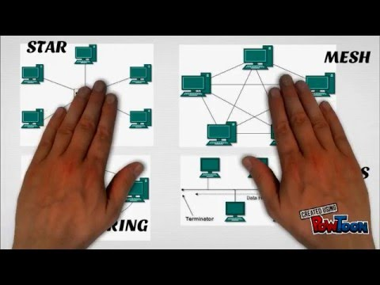
Computer Network
A collection of computing devices connected so that they can communicate and share resources
There are different types of networks available - LAN , WAN, MAN, Ethernet, Wireless

Slide 3
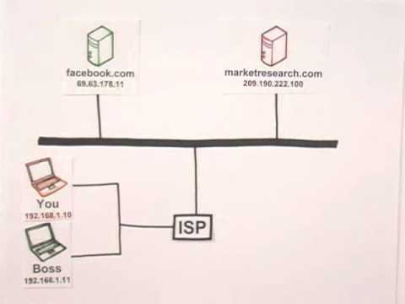
Internet
A wide-area network that spans the planet

Slide 4
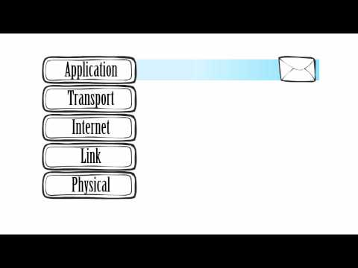
Internet Protocols
A set of rules that defined how data is formatted and processed on a network
Application>Transport>Internet>Link>Physical
SMTP, FTP, Telnet, TCP/IP, HTTP/HTTPS

Slide 5
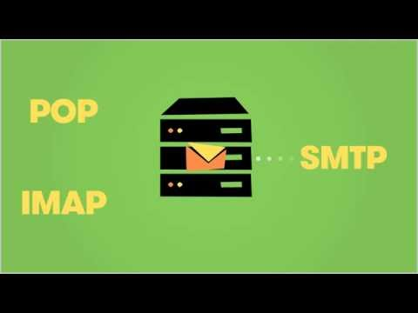
SMTP
Simple Mail Transfer Protocol
A protocol that allows you to send emails from an email client to an email server

Slide 6
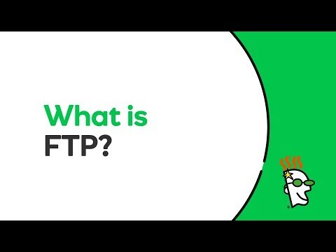
FTP
Files Transfer Protocol
A protocol that computers on the internet use to transfer files to and from one another

Slide 7
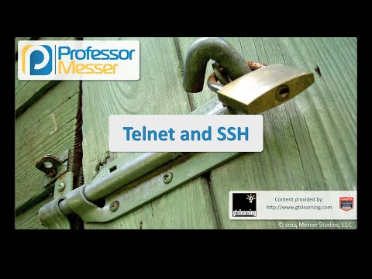
Telnet
Terminal Network
A network protocol used to provide a command line interface for communicating with a device, often remotely

Slide 8
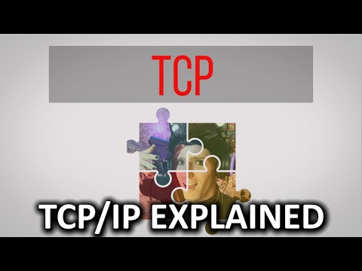
TCP/IP
Transmission Control Protocol & Internet Protocol
A suite of protocols and programs that support low-level network communication

Slide 9
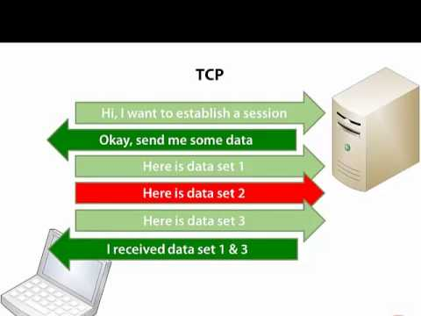
UDP
User Datagram Protocol
An alternative to TCP that achieves higher transmission speeds at the cost of reliability

Slide 10
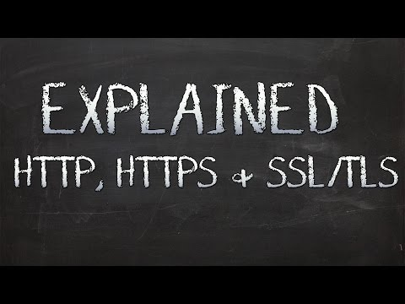
HTTP/HTTPS
Hypertext Transfer Protocol

Slide 11
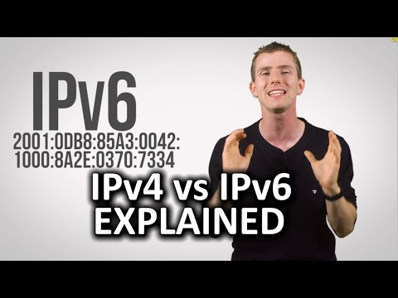
IP Addresses
An address made up of numeric values separated by dots that uniquely identifies a computer on the Internet

Slide 12
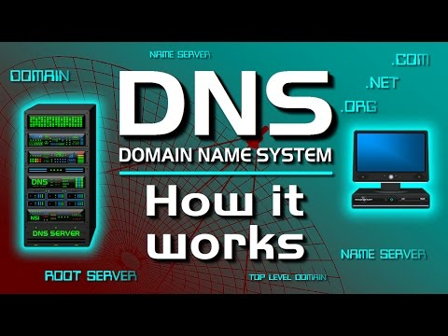
DNS
A database of network names and IP addresses
Domain Name System

Slide 13

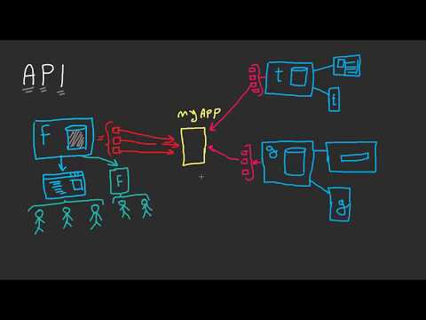
API
A set of subroutine definitions, protocols, and tools for building an application software
Remote APIs, Web APIs
API can be private, partnered, public
Application Programming Interface

Slide 14
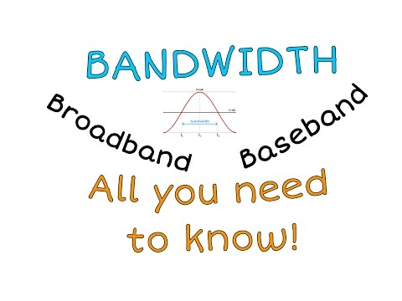
Bandwidth
The number of bits or bytes that can be transmitted from one place to another in a fixed amount of time
Baseband
Broadband

Slide 15
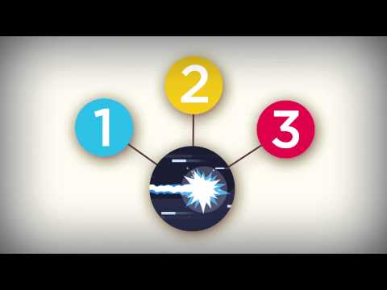
Latency
The time it takes for a specified sector to be in position under the read/write head
Delays in communication

Slide 16
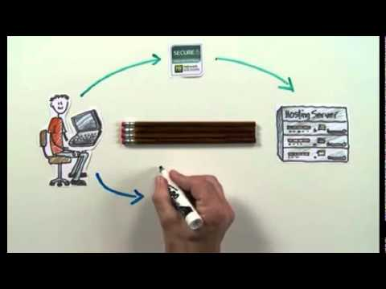
Certificate Authorities
Digital certificate that certifies the ownership of a public key by the named owner of the certificate
CA acts as a trusted third party the owner and the consumer
CA

Slide 17
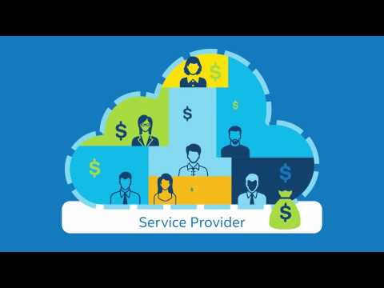
Cloud Computing
A service that provides storage space, automatic synchronization of devices, and access to other resources on the Internet
Easy access anywhere (email on a larger scale)
Public cloud - any subscriber
Private cloud - specific group or organization
Community cloud - shared among two or more organizations with similar needs
Hybrid cloud - some combination of cloud types

Slide 18
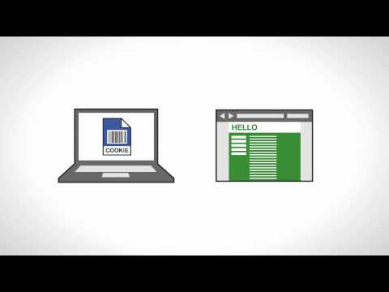
Cookies
Sweet pieces of information
Small files which are stored on the user’s computer

Slide 19
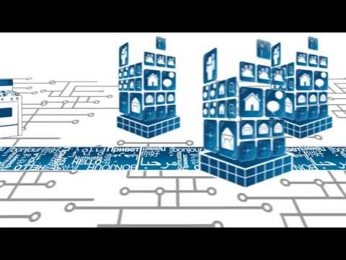
IETF
Internet Engineering Task Force
A large open international community or network designers, operators, vendors, and researchers concerned with the evolution of the Internet architecture and the smooth operation of the Internet

Slide 20

Crowdsourcing
A sourcing model in which individuals or organizations obtain goods and services including ideas and finances, from a large, relatively open and often rapidly-evolving group of internet users
It divides work between participants to achieve a cumulative result

Slide 21
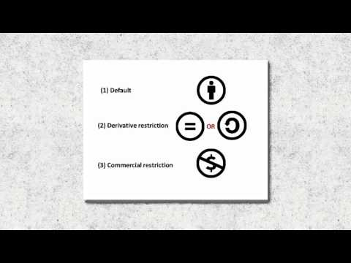
Creative Commons
An American non-profit organization devoted to expanding the range of creative works available for others to build up legally and to share
Licenses free of charge to the public
Cannot be used for profit purposes

Slide 22
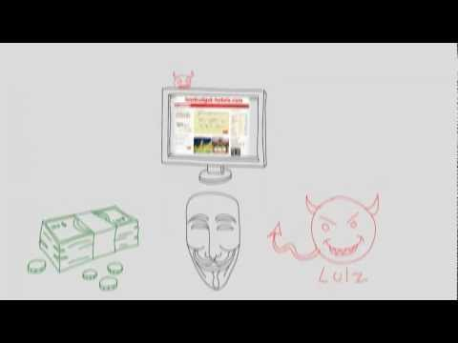
DDoS Attack
An attempt to make an online service unavailable by overwhelming it with traffic from multiple sources
DoS vs. DDoS attacks

Slide 23
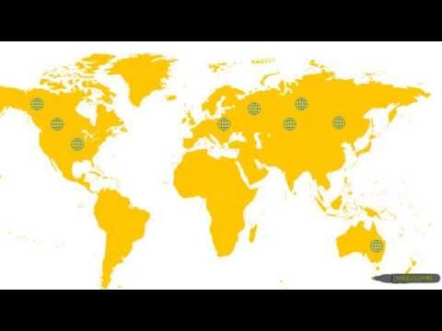
Digital Divide
An economic and social inequality with regard to access to, use of, or impact of information and communication technologies
Bridging the Digital Divide

Slide 24
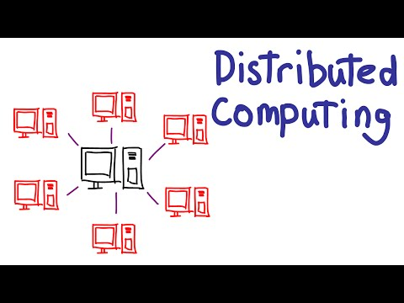
Distributed Computing
A model in which components of a software system are shared among multiple computers, run by a single system, to improve efficacy and performance

Slide 25
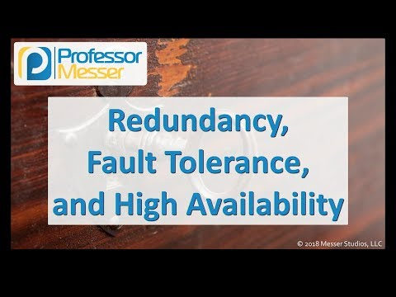
Fault Tolerant Network
Enables a system to continue operating properly in the event of failure of some of its components like a hardware failure or a routing outage or change

Slide 26
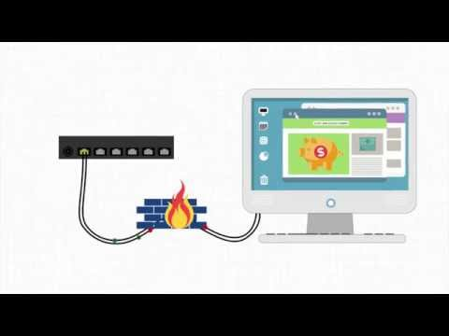
Firewall
A gateway machine and software that protects a network from inappropriate access by filtering the traffic it allows
Enforces an organization’s access control policy - a set of established rules specific to an organization
This is why you can’t watch Youtube or Netflix at school

Slide 27
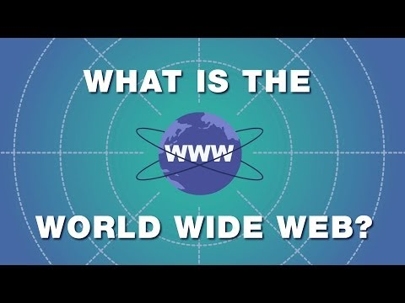
World Wide Web
An infrastructure of distributed information combined with with software that uses networks as a vehicle to exchange that information
A virtual city that host exchanges of information

Slide 28
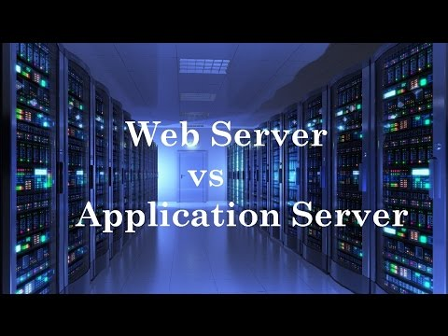
Web Server
A computer dedicated to responding to requests (from the browser client) for web pages
Supports client/server model with User Interface

Slide 29
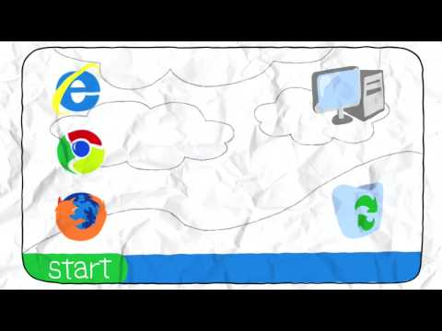
Web Browser
A software tool that retrieves and displays web pages

Slide 30
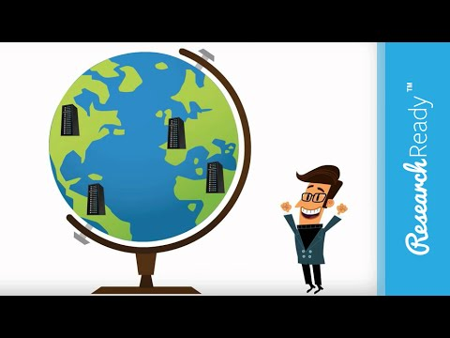
URL
Uniform Resource Locator
A standard way of specifying the location of a web page

Slide 31
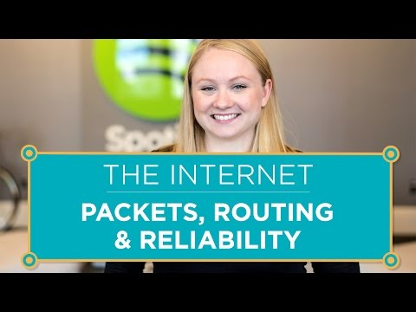
Packets & Routing
Packet is a unit of data sent across a network
Packet switching is an approach to network communication in which packets are individually routed to their destination, then reassembled

Slide 32
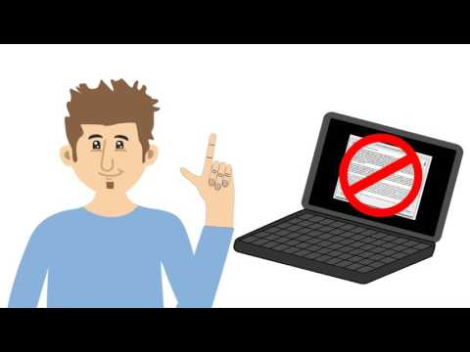
Open Source Software
A computer software with its source code made available with a license in which the copyright holder provides the rights to study, change, and distribute the software to anyone and for any purpose
Linux, Android, Firefox, Google...

Slide 33

OSI Model
Open Systems Interconnection
A conceptual model that characterizes and standardizes the communication functions of a telecommunication or computing system

Slide 34

Online Collaborative Tools
Tools for collaboration

Slide 35
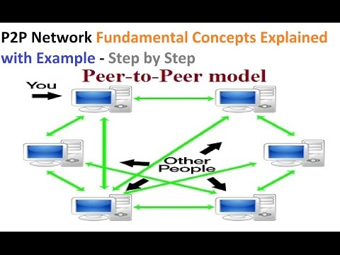
Peer-to-peer Network
Two or more computers are connected via the internet and can share files directly without the need of a central server

Slide 36
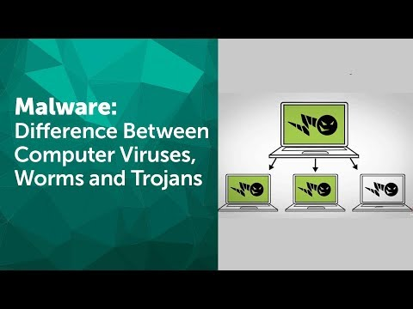
Malware
Software that is intended to damage or disable computer and computer systems

Slide 37
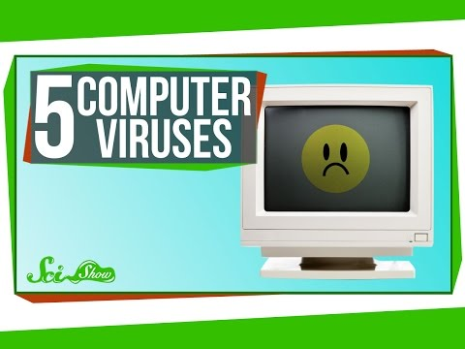
Viruses
A piece of code that is capable of copying itself and corrupting the system or destroying data

Slide 38

Proxy Server
A server that acts as an intermediary for requests from clients seeking resources from other servers
Increases performance and security
Blocks malicious traffic or prohibits certain websites
Logs activity

Slide 39
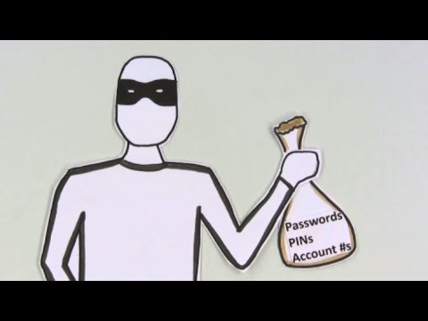
Phishing
Fraudulent through the use of emails

Slide 40
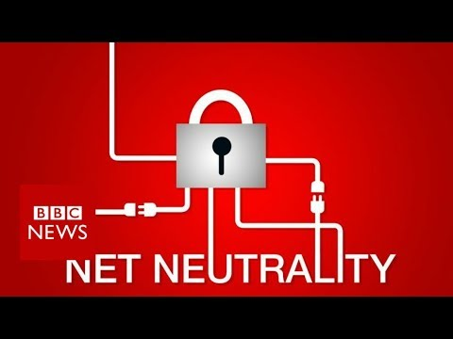
Net Neutrality
The principle that Internet service providers should enable access to all content and applications regardless of the source, and without favoring or blocking particular products or websites

